Slide 1
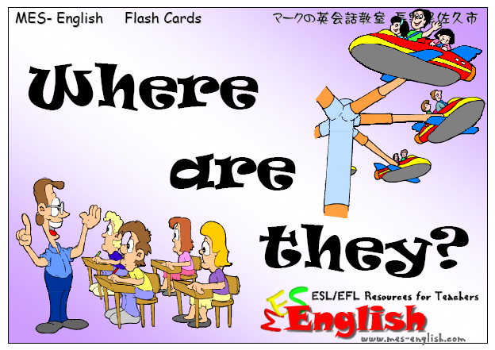
Copyright © 2005 – 2006 MES-English.com

Slide 2
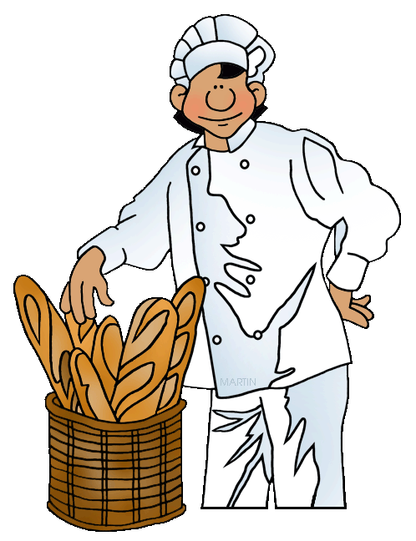
baker’s

Slide 3
bank

Slide 4

bookshop

Slide 5
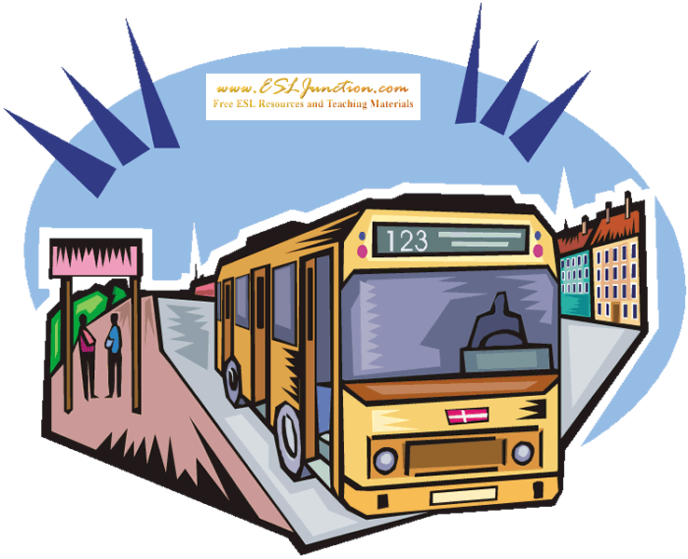
bus station

Slide 6
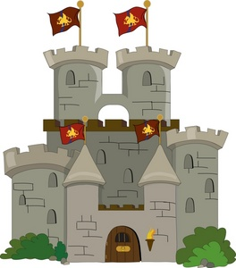
castle

Slide 7

church

Slide 8
cinema

Slide 9

clothes shop

Slide 10
fire station

Slide 11
hospital

Slide 12


Slide 13
library

Slide 14
museum

Slide 15
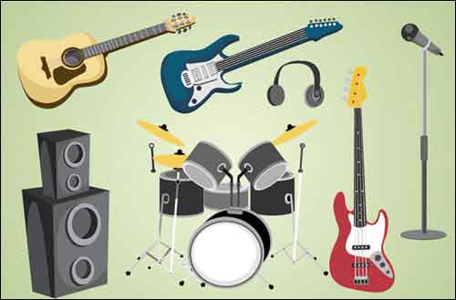
music shop

Slide 16
park

Slide 17

pet shop

Slide 18
playground

Slide 19
police station

Slide 20
post office

Slide 21
restaurant

Slide 22
school

Slide 23
supermarket

Slide 24
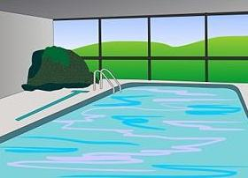
swimming pool

Slide 25
train station

Slide 26
zoo

